Slide 1
Microeconomics
Tim Komarek
Department of Economics
Dragas Center for Economic Analysis and Policy
Strome College of Business

Slide 2

Micro-economics

Slide 3

Micro- vs. Macro-economics
What is “an economy?”
Where do aggregates (“GDP”, “unemployment”, & “inflation”) come from?
Micro:[modelling] Choices and consequences
Macro: [modelling] Systemic interaction of choosers

Slide 4

Economics as a Way of Thinking
Economics is a way of thinking based on a few core ideas:
1) People have objective (goals)
Happiness, profit, etc.
2) There are constraints to achieving goals
$$$, time, etc.

Slide 5


Economics as a Way of Thinking
Economics is a way of thinking based on a few core ideas:
3) People respond to incentives
Money, punishment, taxes and subsidies, risk of injury, reputation, profits, sex, effort, morals
4) Environments adjust until they are in equilibrium
People adjust their choices until optimal, given others’ actions

Slide 6
Constrained Optimization

Slide 7
Optimizing with Constraints
The consumer's constrained optimization problem is:
Choose: < choice set / options >
In order to maximize: < goal >
Subject to: < constraint >

Slide 8
Optimizing with Constraints
The consumer's constrained optimization problem is:
Choose: < choice set / options >
In order to maximize: < goal >
Subject to: < constraint >

Slide 9
Optimizing with Constraints
The consumer's constrained optimization problem is:
Choose: < choice set / options >
In order to maximize: < goal >
Subject to: < constraint >

Slide 10
Optimizing with Constraints
The consumer's constrained optimization problem is:
Choose: < choice set / options >
In order to maximize: < goal >
Subject to: < constraint >

Slide 11
Incentives

Slide 12
Incentives Example: Rat Bounty
Some governments pay bounties to reduce pest populations such as rats.
Example: Suppose the government were to pay $250 for every rat tail turned in.

Slide 13
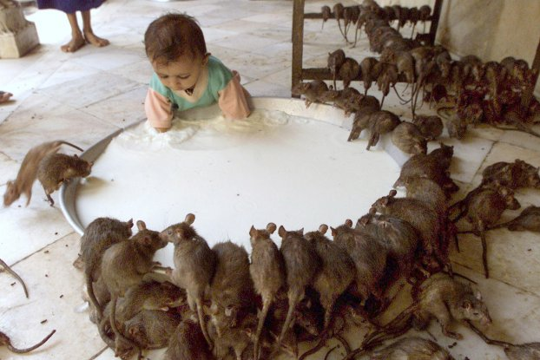
Incentives Example: Rat Bounty
Some governments pay bounties to reduce pest populations such as rats.
Example: Suppose the government were to pay $250 for every rat tail turned in.

Slide 14
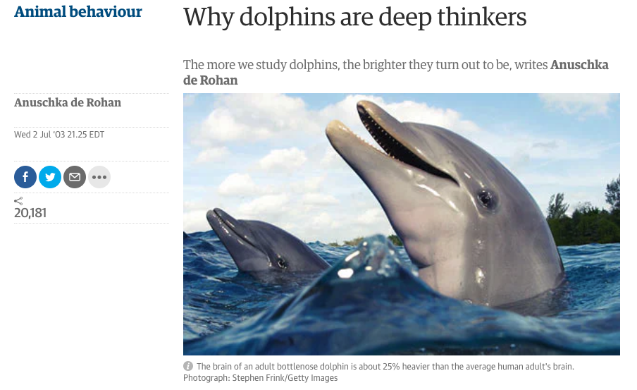
Incentives: Even Dolphins Understand
Source: The Guardian

Slide 15
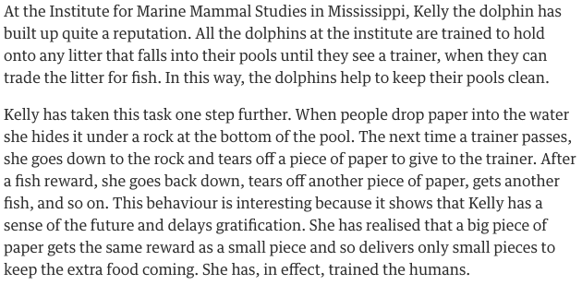
Incentives: Even Dolphins Understand
Source: The Guardian

Slide 16
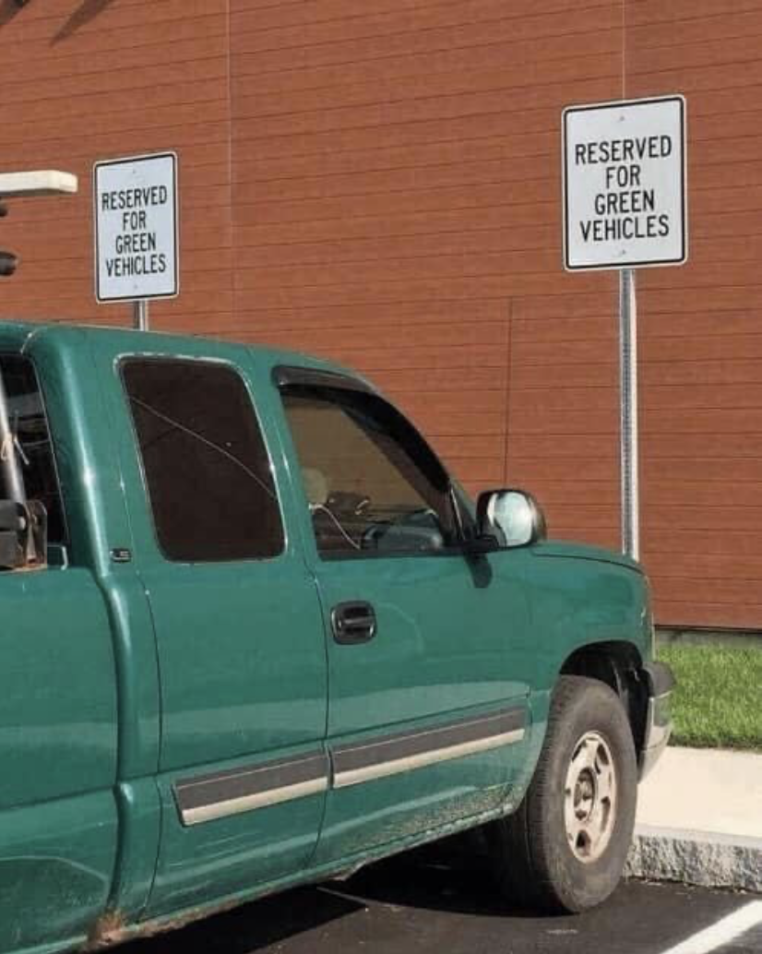
Takeaways About Incentives
People respond to (changes in) incentives
People have goals they seek to attain
Removing one alternative ≠ people stop pursuing their goals
People will seek (less preferred) alternative methods to attain goals
Unintended consequences!

Slide 17
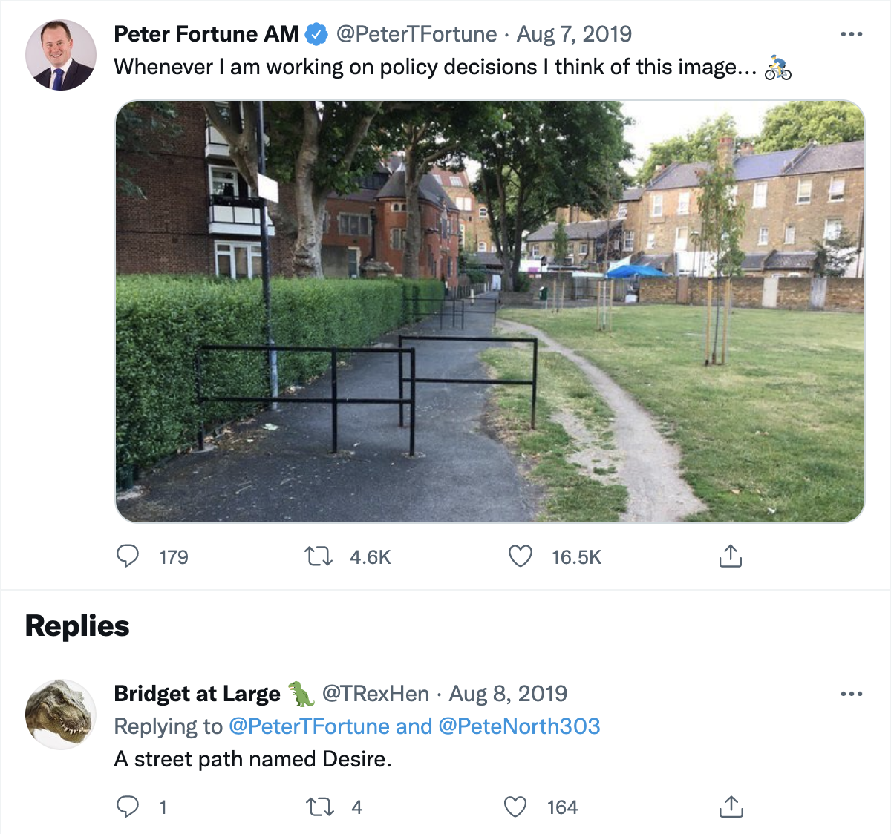
Takeaways About Incentives

Slide 18
Equilibrium

Slide 19
Equilibrium Example

Slide 20
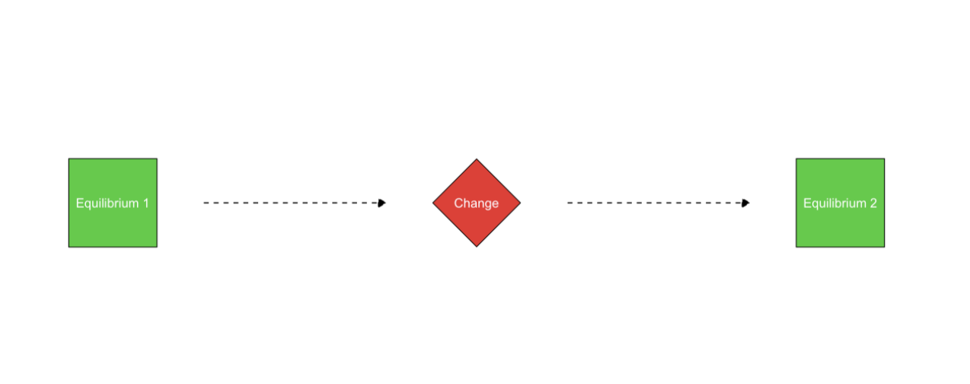
Comparative Statics
Comparative statics: examining changes in equilibria cased by an external change (in incentives, constraints, etc.)

Slide 21
Optimization and Equilibrium
If people can learn and change their behavior, they will always switch to a higher-valued option
If there are no alternatives that are better, people are at an optimum
If everyone is at an optimum, the system is in equilibrium

Slide 22
Models

Slide 23
Economic Model

Slide 24
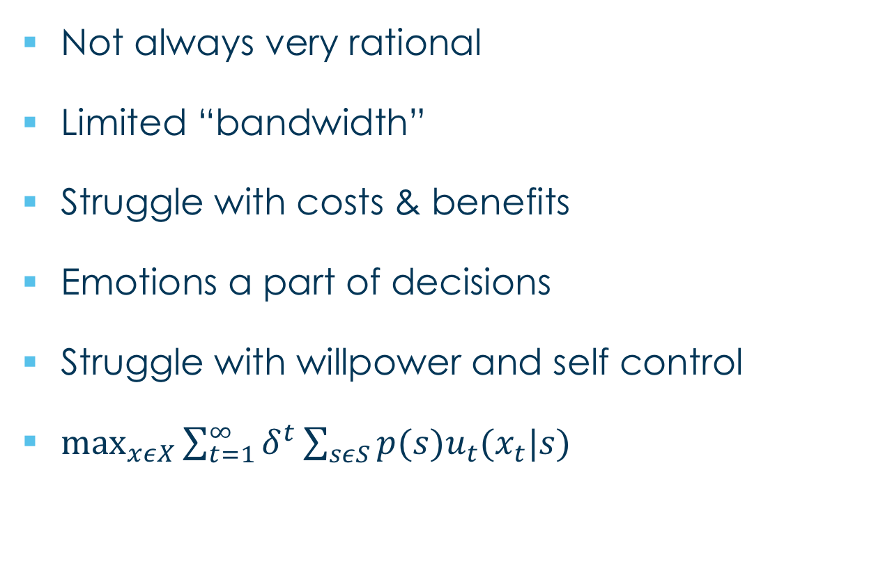
Economic Model
Not always very rational
Limited “bandwidth”
Struggle with costs & benefits
Emotions a part of decisions
Struggle with willpower and self control
$\max_{xεX}{\sum_{t=1}^{∞}{δ^{t}\sum_{sεS}{p(s)u_{t}(x_{t}|s)}}}$
Simplification of reality
Diagrams and equations
Omit some details to focus on what’s really important

Slide 25
Economic Model
Not always very rational
Limited “bandwidth”
Struggle with costs & benefits
Emotions a part of decisions
Struggle with willpower and self control
$\max_{xεX}{\sum_{t=1}^{∞}{δ^{t}\sum_{sεS}{p(s)u_{t}(x_{t}|s)}}}$
Simplification of reality
Diagrams and equations
Omit some details to focus on what’s really important
Built on assumptions of how the world works

Slide 26
Economic Model
Not always very rational
Limited “bandwidth”
Struggle with costs & benefits
Emotions a part of decisions
Struggle with willpower and self control
$\max_{xεX}{\sum_{t=1}^{∞}{δ^{t}\sum_{sεS}{p(s)u_{t}(x_{t}|s)}}}$
Simplification of reality
Diagrams and equations
Omit some details to focus on what’s really important
Built on assumptions of how the world works

Slide 27
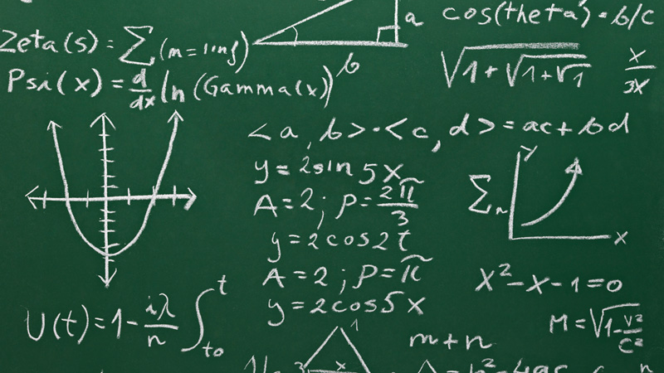
Economic Model
Not always very rational
Limited “bandwidth”
Struggle with costs & benefits
Emotions a part of decisions
Struggle with willpower and self control
$\max_{xεX}{\sum_{t=1}^{∞}{δ^{t}\sum_{sεS}{p(s)u_{t}(x_{t}|s)}}}$
Economists often “speak” in models that explain and predict human behavior
The pure language of models is mathematics
things that are universally true, deducible from axioms
clear about assumptions
often equations and graphs
“All models lie. The art is telling useful lies.” - George Box

Slide 28

Economic Model
Optimization
Agents have objects they value
Agents face constraints
Make tradeoffs to maximize objectives within constraints
Equilibrium
Agents compete with others over scarce resources
Agents adjust behaviors based on prices
Stable outcomes when adjustments stop

Slide 29
Economic Model
Caution: Don't conflate models with reality!
Models help us understand reality.
A good economist is always aware of:
“ceterus paribus”
“...and then what?”
“...compared to what?”

Slide 30
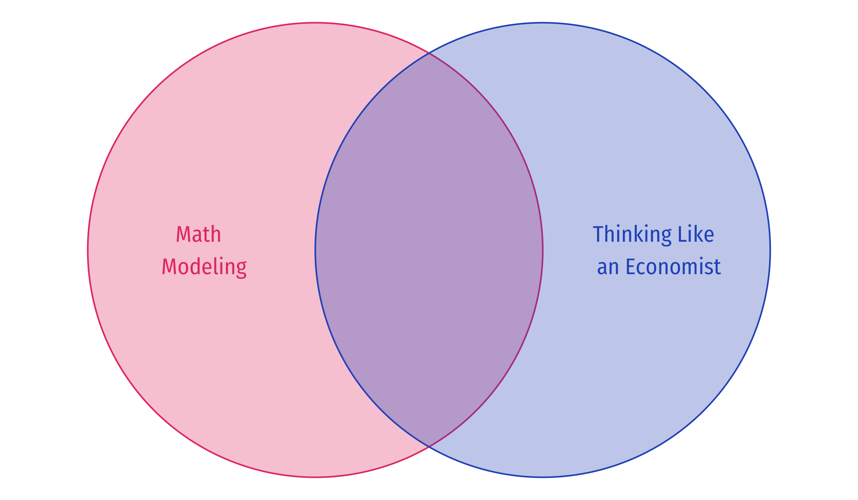
Economics Uses, but Is Not Limited to, Math

Slide 31
Let’s think about a model
Pricing decision
Based on work by John List
Mechanic
Handicap accessible van
Service on ding in the bumper
What price does the mechanic charge?

Slide 32
Let’s think about a model
Question: Why do people receive different treatment in markets?
Discrimination because of disgust or animosity (Becker 1957)
Altruism
Third-degree price discrimination
Make $$
Maybe handicap drivers search less?

Slide 33
Econometrics
Natural field experiment
Leveraging the power of randomization
Took a list of mechanics in Chicago and randomly chose where to get a quote "Flipped a coin" on the driver that goes (handicap or non-handicap)
The treatment status is independent of:
The potential outcomes
Participant characteristics

Slide 34
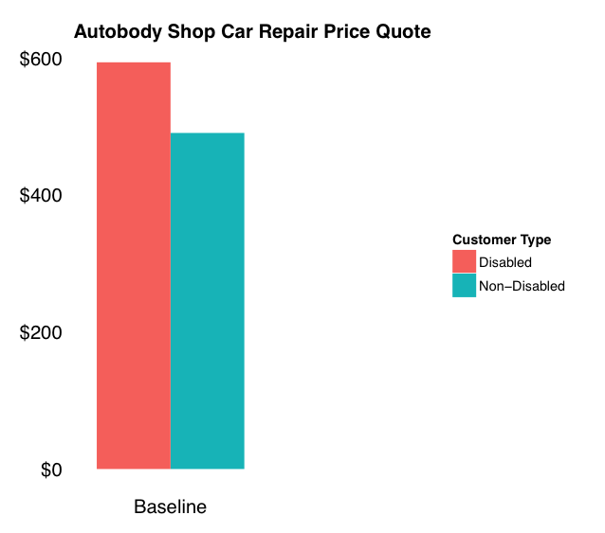
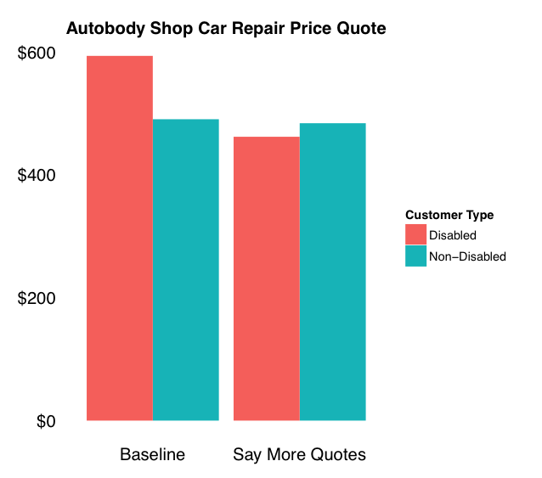
Empirical results

Slide 35
Empirical results

Slide 36
Empirical results
“I’m just out getting a few quotes today”

Slide 37
Empirical results
“I’m just out getting a few quotes today”

Slide 38
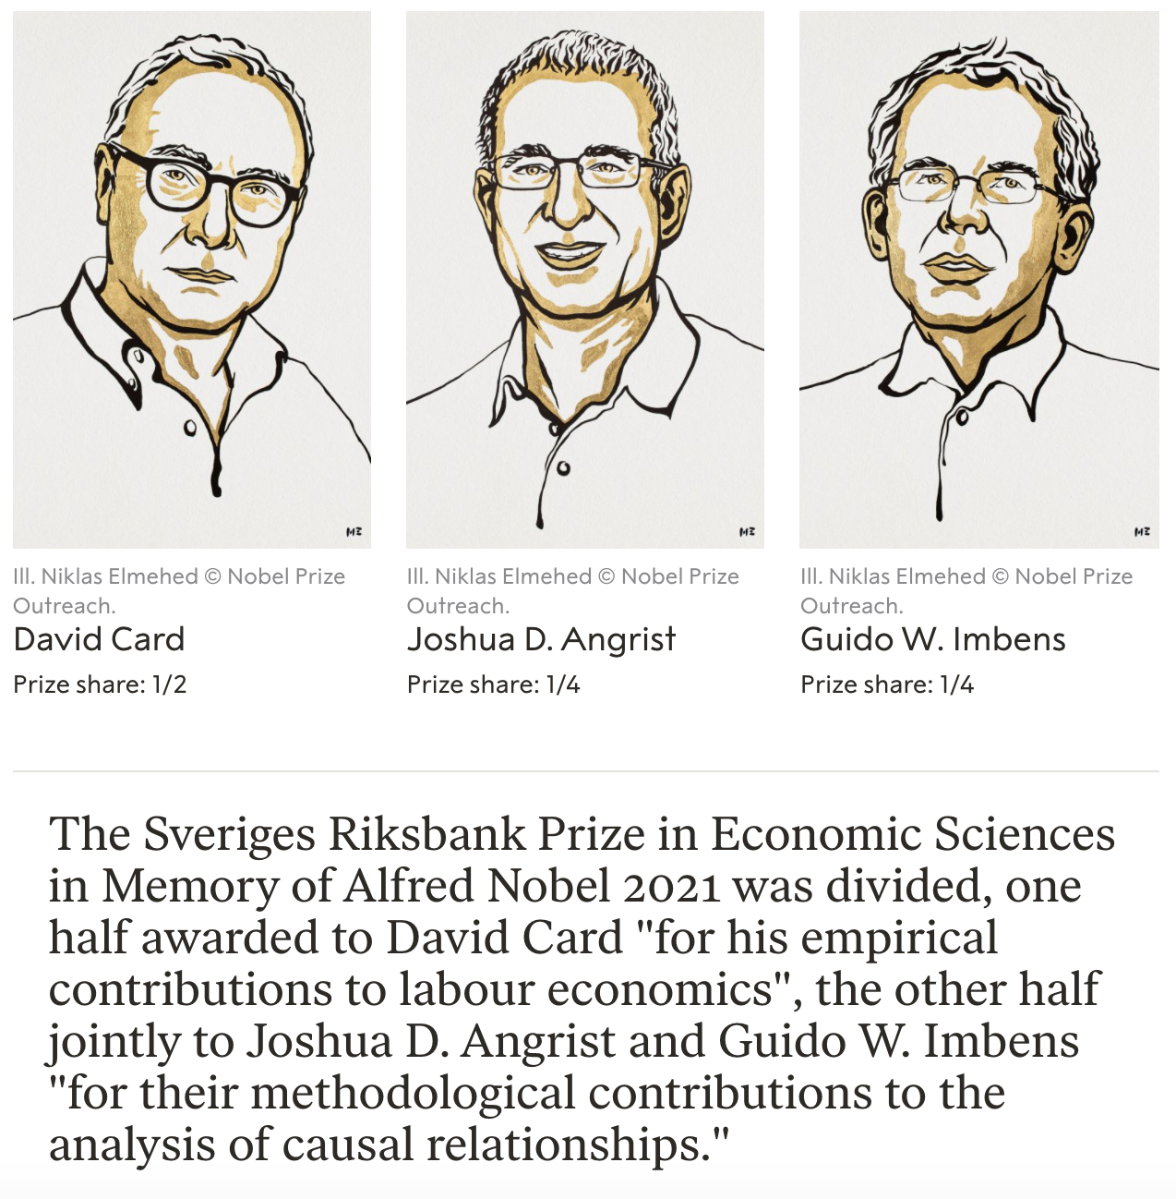
Natural Experiments and Quasi-Experimental Methods

